Slide 1
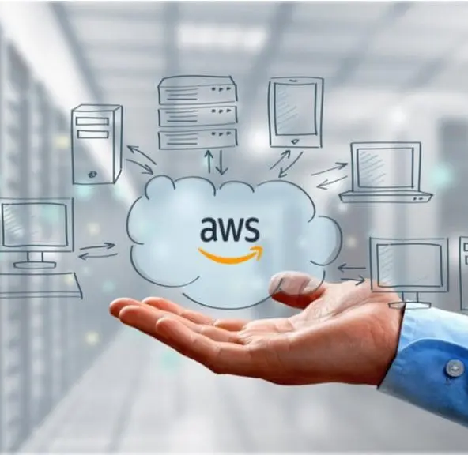

FabClothing
Cloud Migration Strategy
AWS Cloud Migration Business Case & Proof of Concept
Precious Mbah
16/09/26

Slide 2
Current environment & challenges
Limited Scalability
The physical infrastructure has a fixed capacity. Which is not suitable ofr peak periods
Resource utilisation
When excess resources are bought to cope with peak sales season, those resources end up not being used regularly, which is a waste of money.
Hardware maintenance requirements
IT Team needs to constantly replace and manage the physical hardware and servers, which requires lots of time and money
Disaster recovery problems
Reliance on physical infrastructure creates additional requirements around backup, hardware failure and disaster recovery .

Slide 3
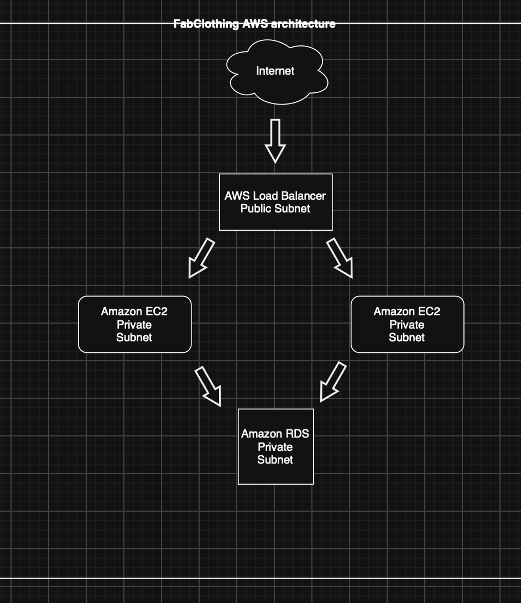
Proposed AWS Architecture
Internet
  A global network of computers
Load Balancer
  This helps to distribute customer request
  EC2
  It is like a virtual computer so it runs the applications workload
  RDS
  This acts as a virtual database, so it stores Cutomers data
  S3
  This acts as an object storage, so it stores files and images/documents

Slide 4
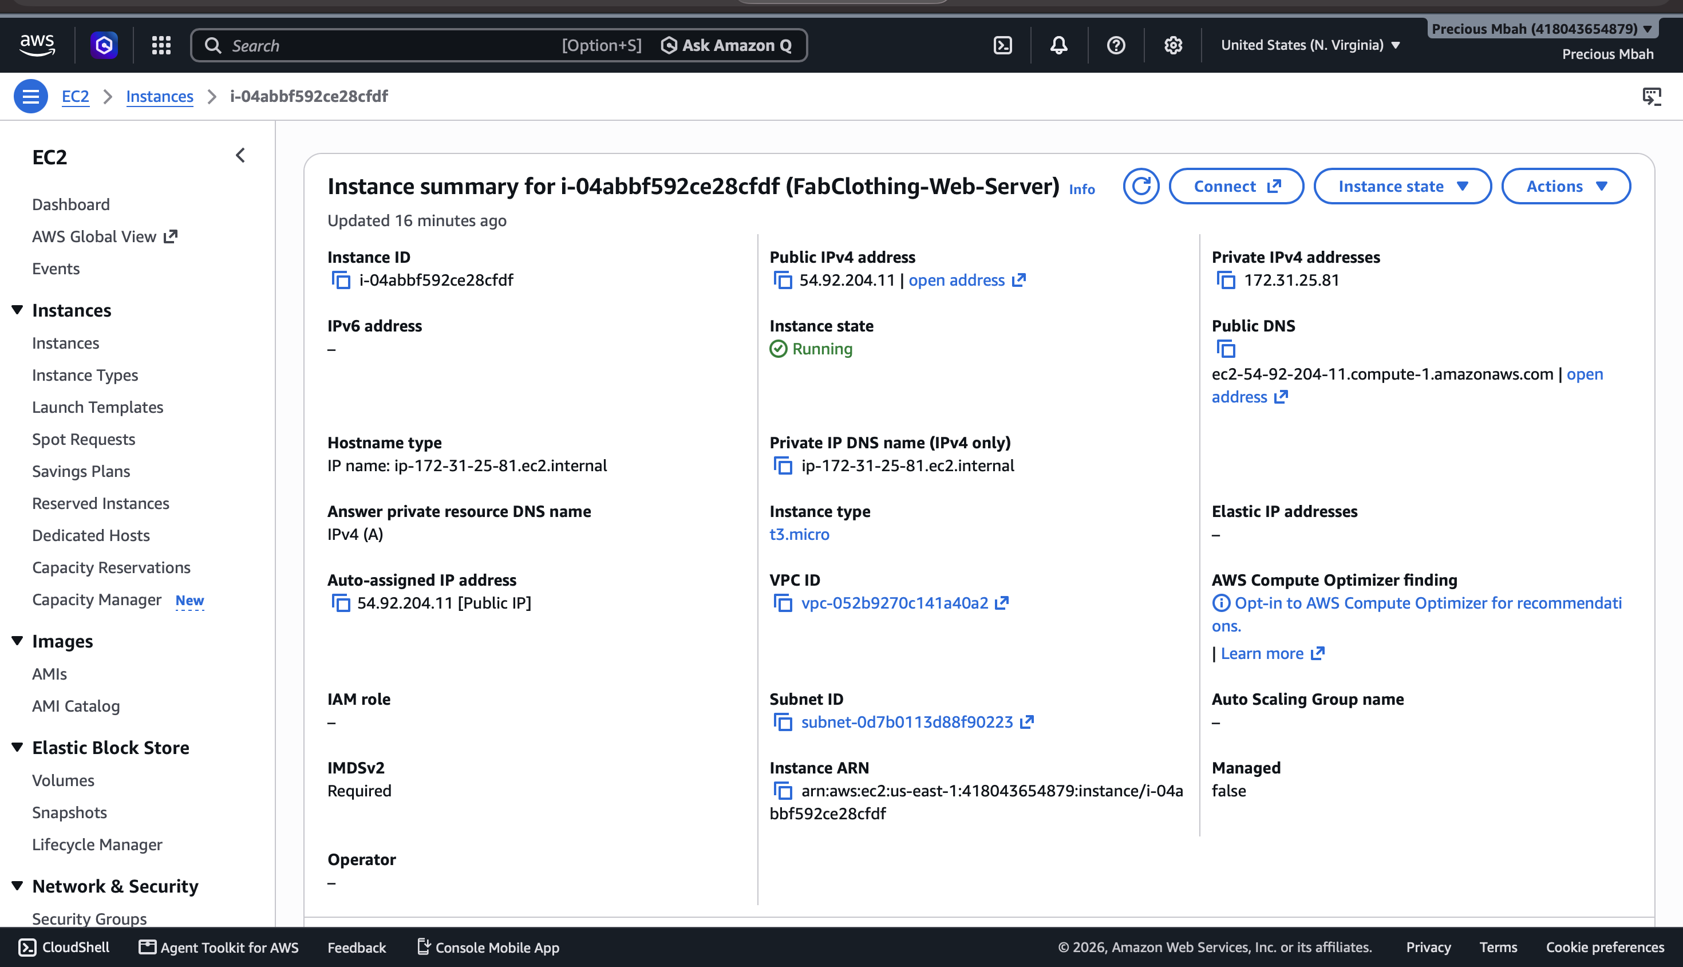
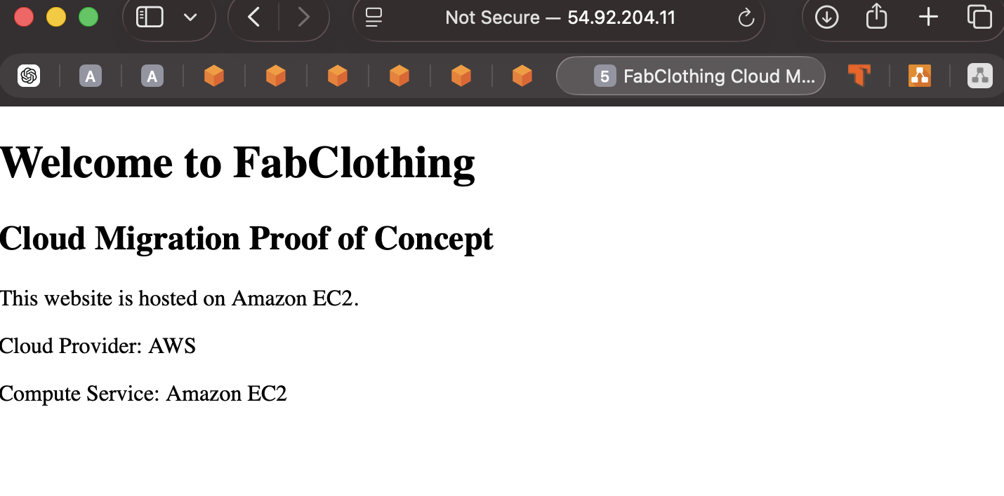
Aws Proof of concept
POC Result: Successfully deployed a web server on Amazon EC2 and hosted the FabClothing webpage using Apache.
This architecture is made up of a single Amazon EC2 instance in an AWS VPC and this instance is assigned to a public address which allows HTTP request from the internet to reach the web server. An EC2 security/firewall is used to control network traffic.

Slide 5
Migration strategy and risk
Stragety
Risk
Assess | Data Loss
Design | Downtime
Build | ,Security misconfiguration
Pilot | Migration delays
Migrate Optimise | Unexpected cost

Slide 6
Proposed next steps
Complete detailed infrastructure assessment
Validate AWS costs using actual workloads
Build a controlled pilot environment
Test application and database migration
Progressively migrate production workloads
Monitor and optimise the AWS environment

